Slide 1
Digital Onboarding:
Introduction to Verification
Silicats

Slide 2
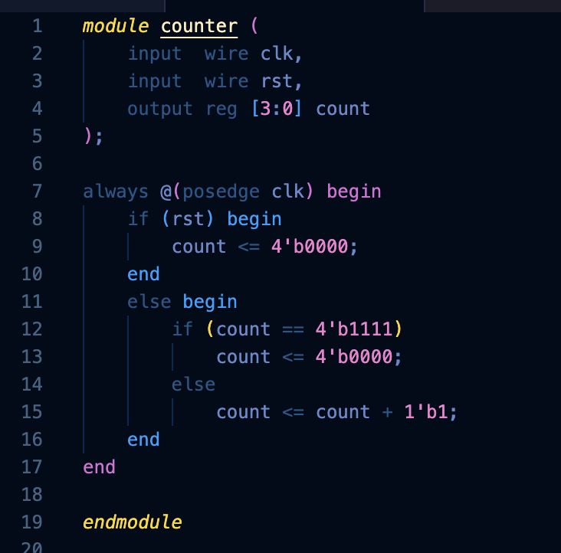
What is Verification?
How do we know this design works?
Designs have thousands to millions of possible input combinations.
What would it take to actually be confident this is correct?
Verification is the systematic process of confirming a design behaves according to its specification.
Verification ≠ testing: testing checks specific cases, verification aims for confidence across all cases
Verification ≠ debugging: debugging happens after verification finds a problem
Applies at every level: individual modules, subsystems, and full-chip integration
Notes:
Ask their thoughts on how to know if this design works.
Design is simple but as they grow, then they become more complicated as they have more inputs and states.

Slide 3
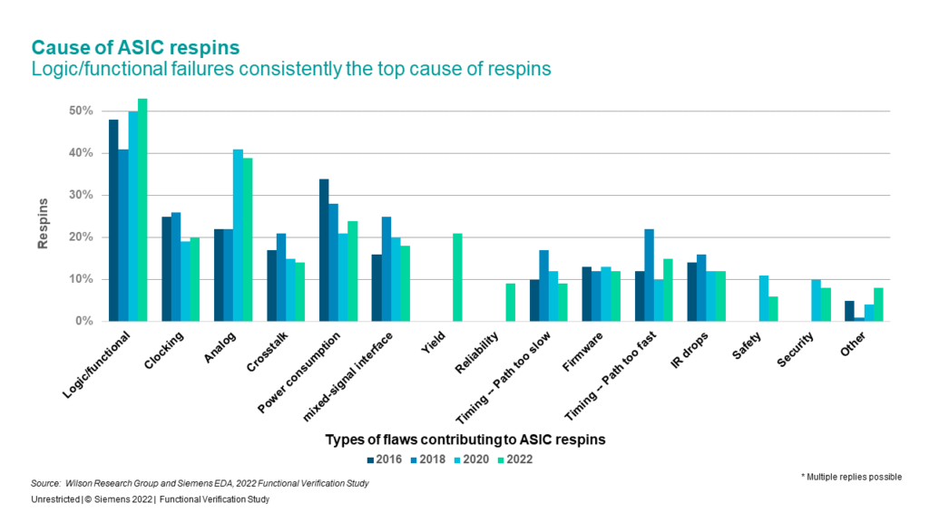

Slide 4
Types of Tests
Directed tests: hand-crafted inputs targeting a specific scenario or known behavior (e.g., "check that 2+2=4", rst is correctly resetting values)
Random tests: randomly generated inputs to catch unexpected edge cases you didn't think to write directly
Constrained-random tests: randomness within defined rules (e.g., random values, but always within valid input ranges)
Regression tests: a saved suite of tests re-run every time the design changes, to catch bugs that get reintroduced
Corner-case tests: deliberately targeting boundary/edge conditions (overflow, reset-during-operation, simultaneous events)
Smoke tests: quick, basic tests to confirm the design isn't fundamentally broken before running the full suite

Slide 5
Bugs and Debugging
What a bug is: any behavior that doesn't match the intended specification
The debugging loop: reproduce → isolate → identify root cause → fix → re-verify
Bugs are rarely obvious, most are found through deliberate, structured testing
In industry, verification engineers often outnumber design engineers on a team
A single missed bug in silicon can cost millions of dollars and months of delay
Tools for debugging
  Waveform viewers (e.g., ModelSim): trace signal values over time to see exactly where behavior diverges from expectation
  Divide and conquer: narrow down where the bug lives
  Print/log statements: add $display messages to trace values at key points
  Assertions: flag violations when they happen
  Isolate the minimal failing case

Slide 6
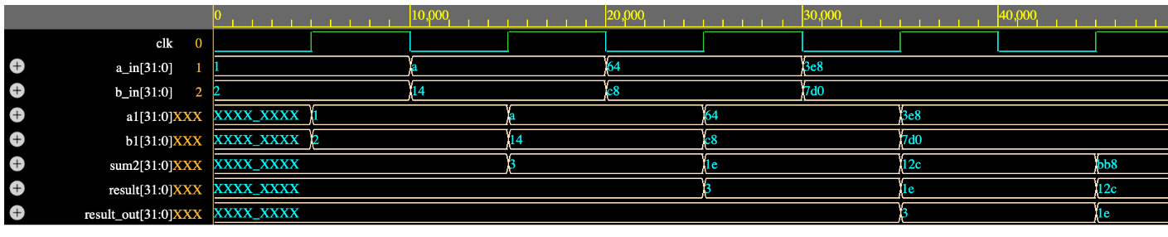
Waveform Debugging Example
Intended Specification:
The module is a three-stage pipelined 32-bit adder. It should capture a_in and b_in in Stage 0, calculate their sum in Stage 1, and present that sum at result_out in Stage 2.

Slide 7
Waveform Debugging Answer
Intended Specification:
The module is a three-stage pipelined 32-bit adder. It should capture a_in and b_in in Stage 0, calculate their sum in Stage 1, and present that sum at result_out in Stage 2.
Therefore, each input pair’s sum should appear at result_out exactly three rising clock edges after that pair is sampled. In the waveform, result_out appears one clock edge after result, revealing an unintended fourth pipeline stage.

Slide 8
The End

